Slide 1

Time Interactive Notebook
Name
Class
Teacher
Term 3 Semester 2
1

Slide 2
Tasks
24
7
30
Essential Question
Questions
Notes
Summary
4
5

Slide 3
Elapsed Time
The school starts at 8:35 am and finished at 2:40 pm. What is the time spent you spend at school?

Slide 4
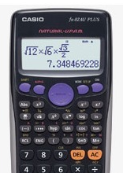
Adding and Subtracting Time using your calculator
Convert times to 24 hours first
Example 1 : What time will it be a 6 hours 20 minutes after 10:15 a.m.?
10:15 am = 1015
1015 + 0620 =
1
0
º ’ ”
1
5
º ’ ”
+
6
º ’ ”
2
0
º ’ ”
=

Slide 5
24
7
30
Date
Time Zones
EQ – What are time zones and how do they affect our lives?
Summary:
5

Slide 6
Time Zones Video
http://splash.abc.net.au/home#!/media/1950553/time-zones

Slide 7
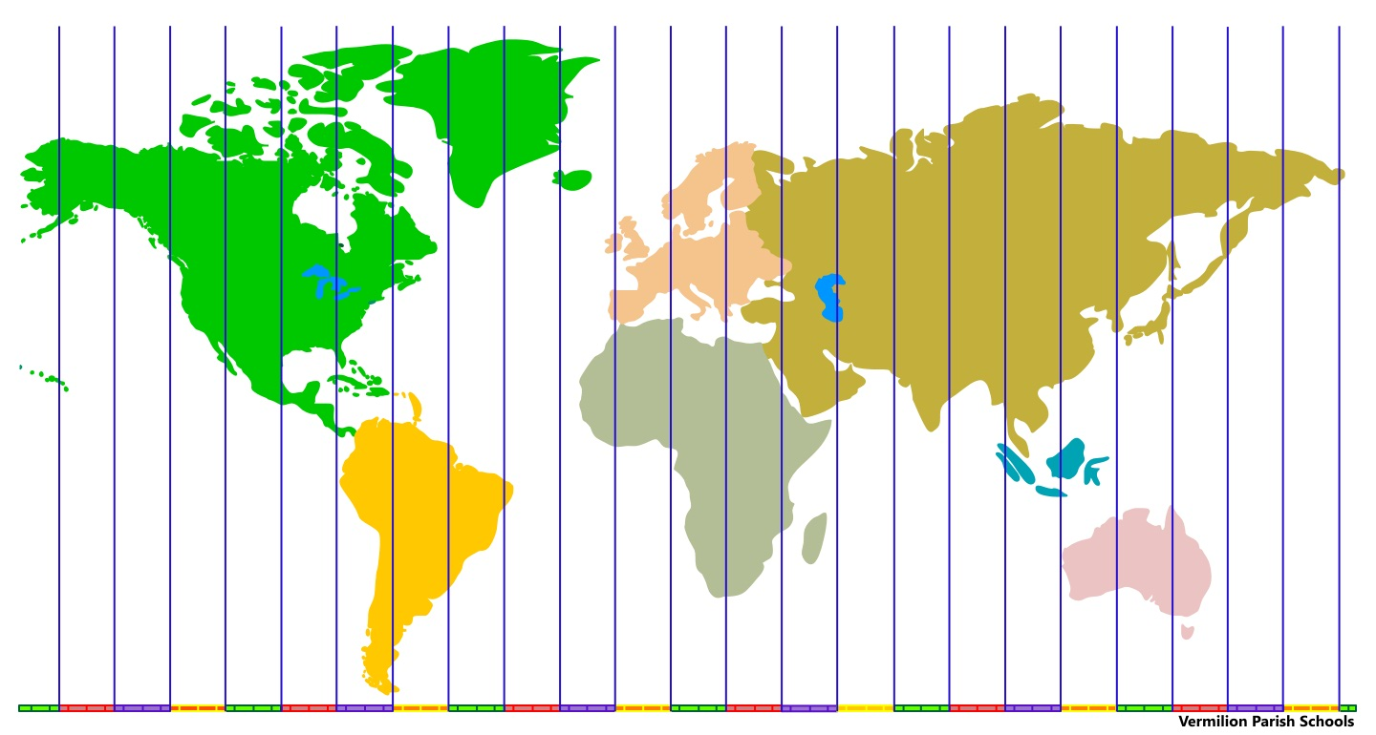
24
7
30
Date
Time Zones
EQ – What are time zones and how do they affect our lives?
Vocabulary
A time zone is a region of the earth that has the same time. There are 24 time zones.
5

Slide 8
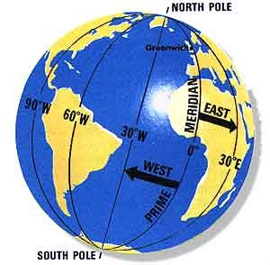
Greenwich, England is the starting point for time zones
The world rotates west to east (counterclockwise), time zones to the east are ahead of the those time zones to the west

Slide 9
LONGITUDE AND TIME
The world rotates (spins) _____° in ___ hours.
How many degrees per hour does the earth spin?
360° / 24 hours = 15° per hour
The world has 24 time zones, each 15° apart.
THERE IS A 1 HOUR TIME DIFFERENCE FOR EVERY 15° OF LONGITUDE (vertical lines on a map, similar to time zones)

Slide 10
24
7
30
Date
Time Zones
EQ – What are time zones and how do they affect our lives?
Think of it as a giant number line.
Greenwich, England is at 0 on the number line. As you move to the left you add, as you move to the right you subtract.
-2
Sandwich Islands
-1
Dakar
0
Greenwich
+1
Paris
+2
Cape Town
5

Slide 11
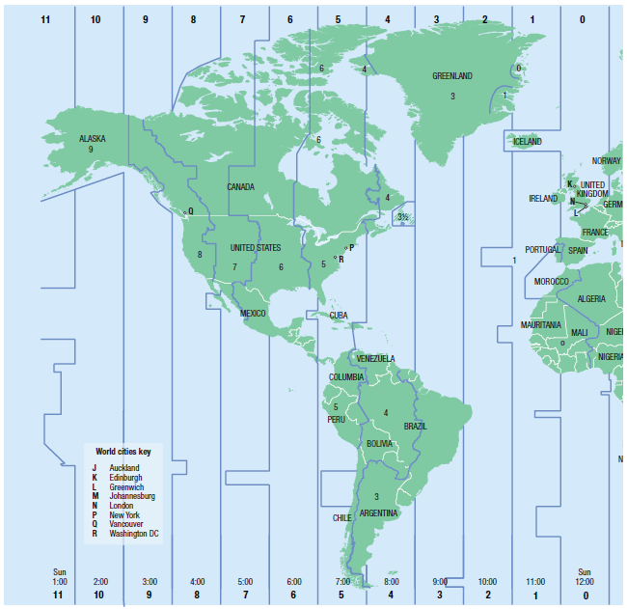
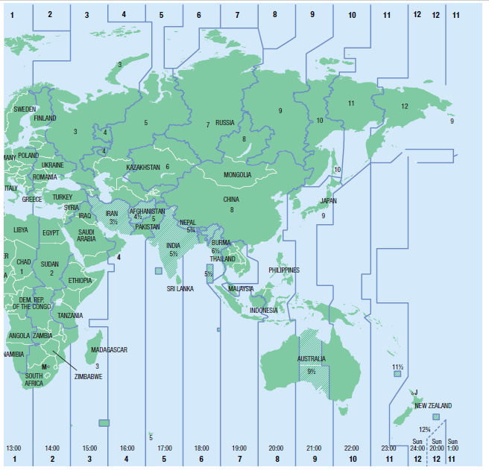
Time zones (World)
When it is 2:00 pm in Greenwich London, find the time in these places:
1) South Africa, 2) China, 3) New York, 4) Queensland and 5) Alaska

Slide 12
Time zones (World)
What is the time difference between:
1) India and China, 2) WA and New York, 3) Argentina and Alaska

Slide 13
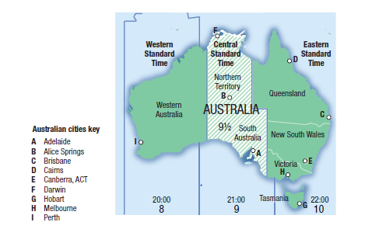
24
7
30
Date
Time Zones
EQ – What are the time zones in Australia?
How many time zones does Australia have?
There are three time zones in Australia
1. AEST (GMT+10) – Sydney, Melbourne, Brisbane, Gold Coast, Cairns, Hobart.
2. AWST (GMT+8 ) – Perth
3. ACST (GMT +9.5) – Darwin, Alice Spring and Adelaide
Summary:
5

Slide 14
Time zones (Australia)
When it is 9:35 am in New South Wales, Australia, find the time in these places.
i Alice Springs
ii Perth
iii London

Slide 15
You Do
Essential Mathematics 8, Exercise 4 J, Q 9-11, pg 235-236,

